Slide 1
Group 4
IP Address

Slide 2
What is IP address?
An IP address is a number identifying of a computer or another device on the Internet. It is similar to a mailing address, which identifies where postal mail comes from and where it should be delivered. IP addresses uniquely identify the source and destination of data transmitted with the Internet Protocol.

Slide 3
Types of IP addresses
IPv4
IPv4 uses 32 binary bits to create a single unique address on the network. An IPv4 address is expressed by four numbers separated by dots. Each number is the decimal (base-10) representation for an eight-digit binary (base-2) number, also called an octet. For example: 216.27.61.137
IPv6
IPv6 uses 128 binary bits to create a single unique address on the network. An IPv6 address is expressed by eight groups of hexadecimal (base-16) numbers separated by colons, as in 2001:cdba:0000:0000:0000:0000:3257:9652. Groups of numbers that contain all zeros are often omitted to save space, leaving a colon separator to mark the gap (as in 2001:cdba::3257:9652).

Slide 4
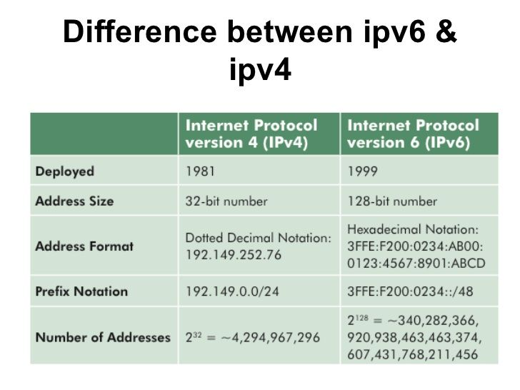
Difference between IP version 4 and IP version 6.

Slide 5
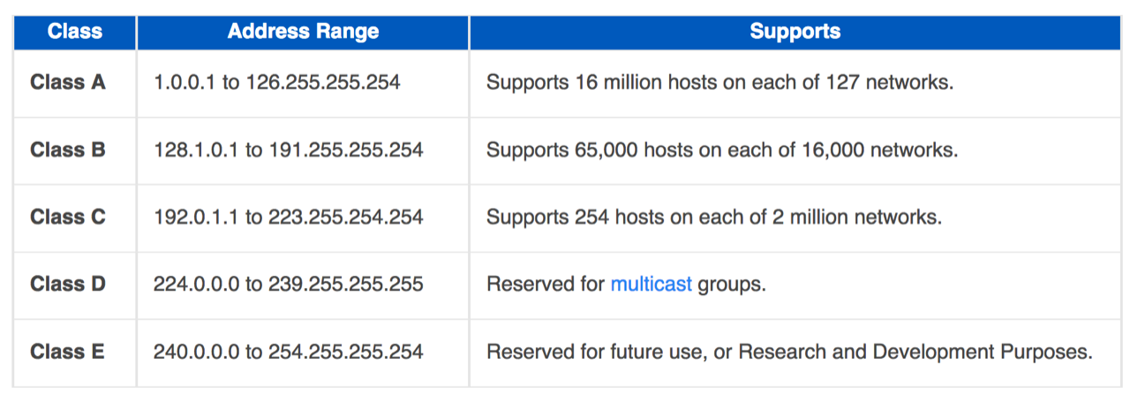
IP address classes

Slide 6
Note: Ranges 127.x.x.x are reserved for the loopback or localhost, for example, 127.0.0.1 is the loopback address. Range 255.255.255.255 broadcasts to all hosts on the local network.
Loopback address: Loopback IP address is managed entirely by and within the operating system. These addresses enable the Server and Client processes on a single system to communicate with each other.
The localhost is the default name describing the local computer address also known as the loopback address.

Slide 7
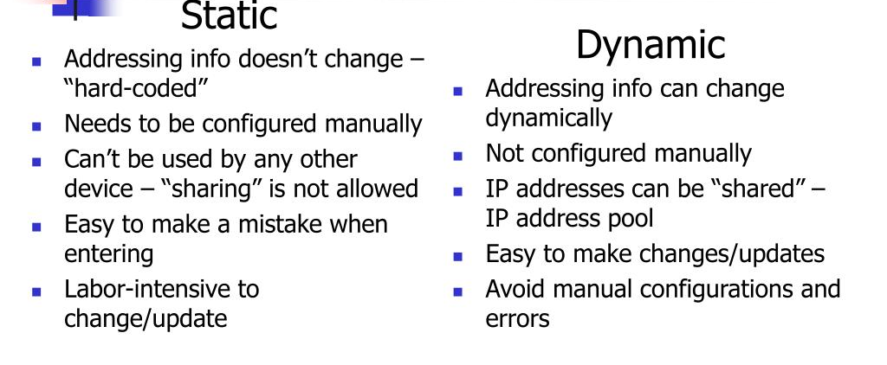
Static vs. dynamic IP addresses

Slide 8
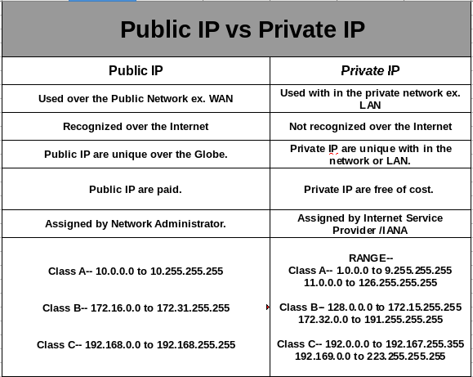
Private and Public IP addresses

